Slide 1
ASE Project
Smart Shop
Anusha Jasti - 18
Joshmitha Tammareddy - 49

Slide 2
About the project
To Integrate API’s and show the results in a single window.
To make the search easy using camera integration.

Slide 3
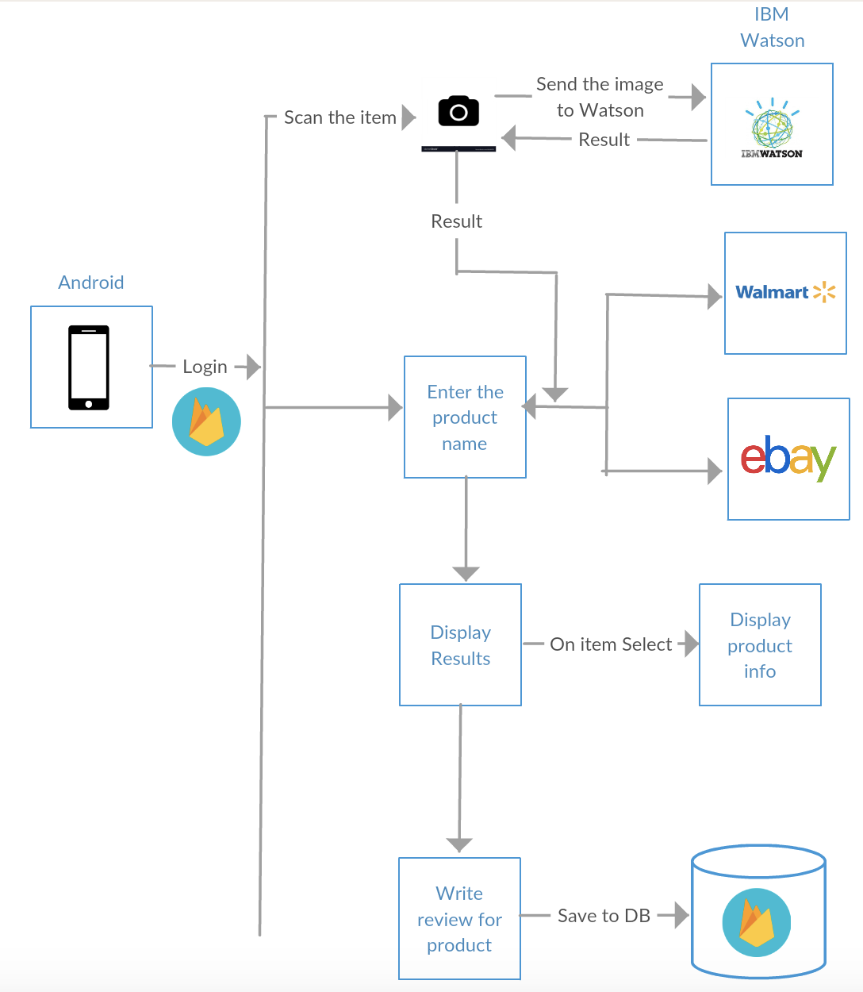
Architecture

Slide 4
Technologies used:
Android
Firebase

Slide 5
API’s used:
Walmart
Ebay
IBM Watson

Slide 6
Features:
OAuth using Google or Facebook and user registration and login using firebase.
Camara Integration for the product search and also keyword search
Image Recognition using IBM Watson API.
Integration of API’s : Walmart and Ebay
Product Description and images
Reviews by authenticated users are stored in database.
Navigation to the merchandile website.

Slide 7
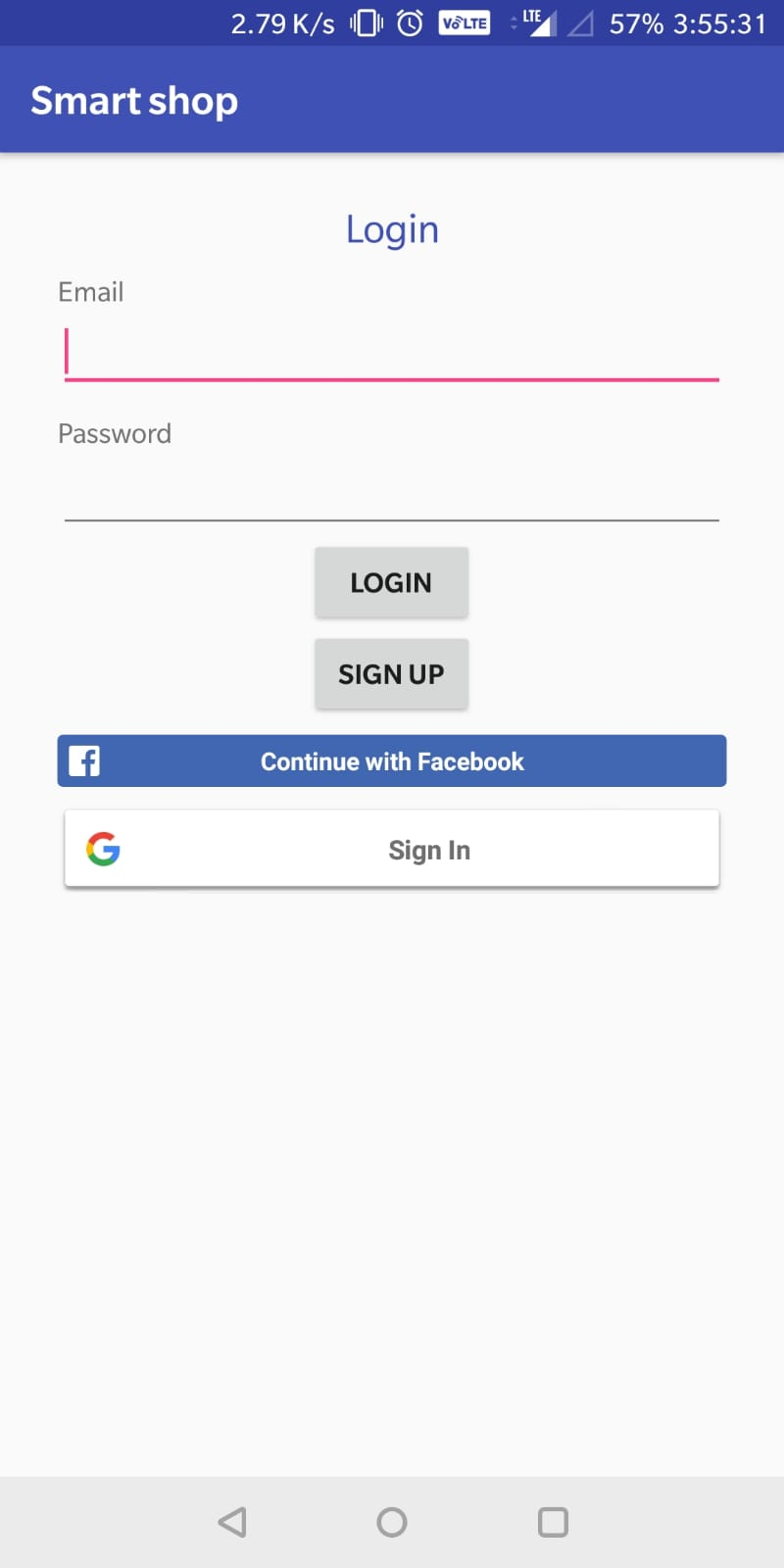
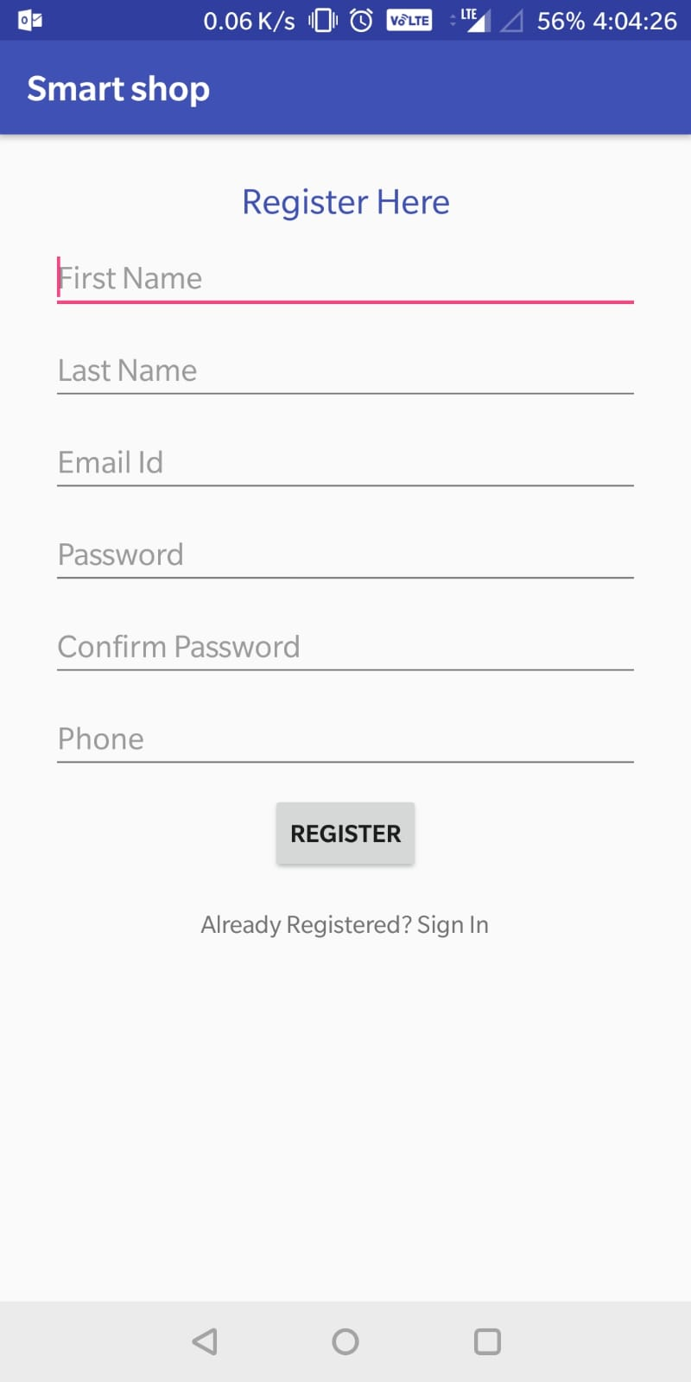
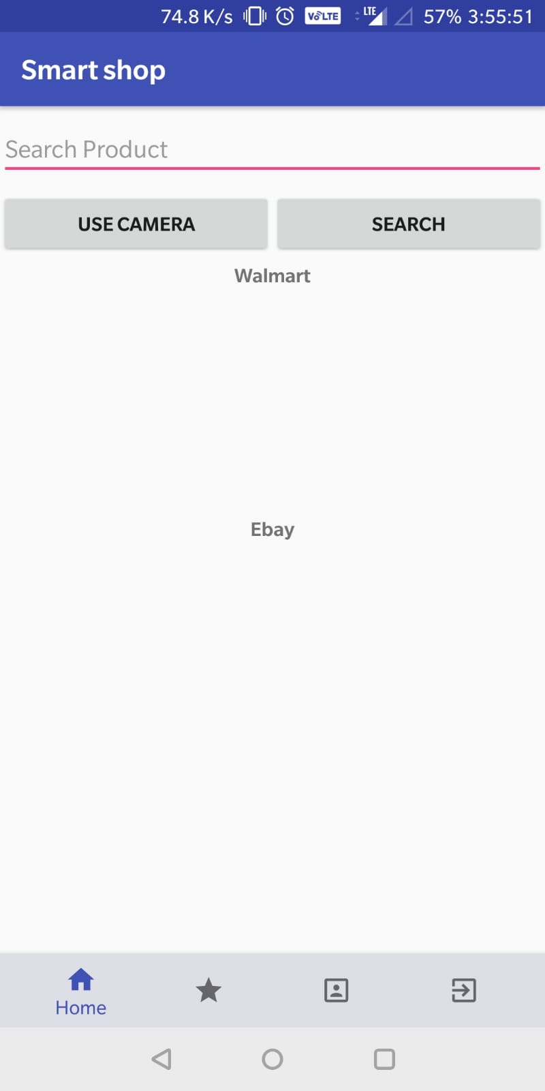

Slide 8
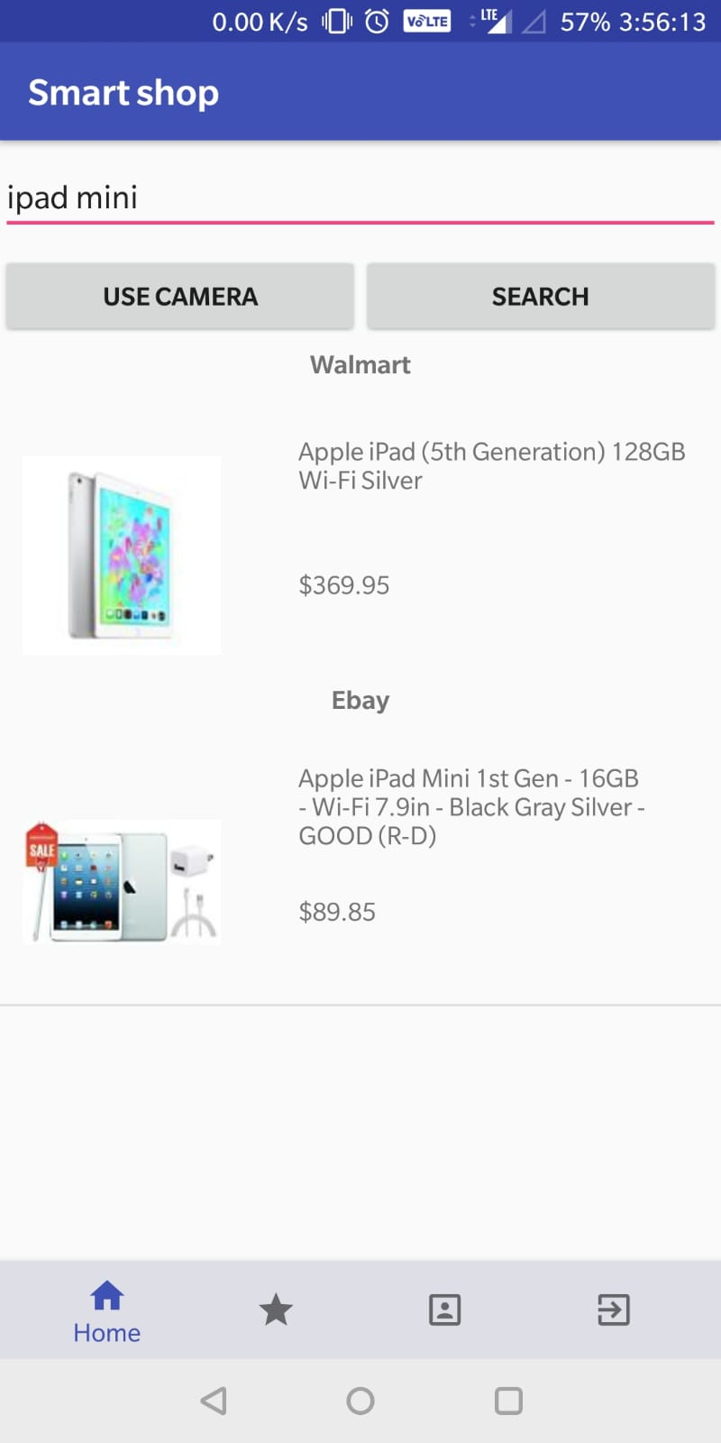
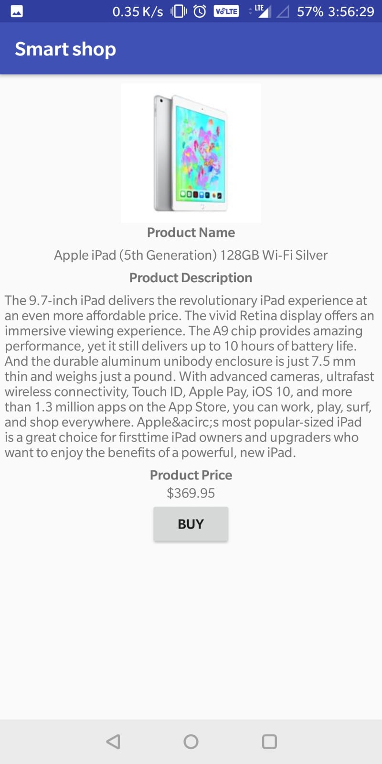
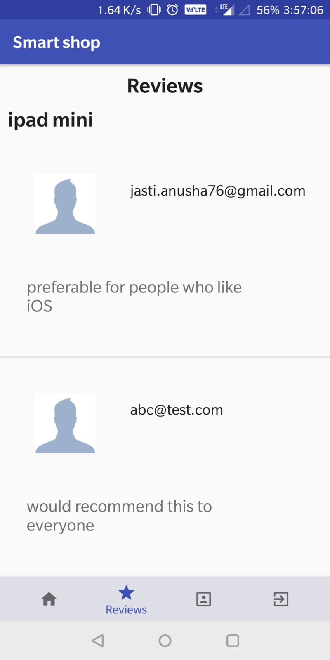

Slide 9
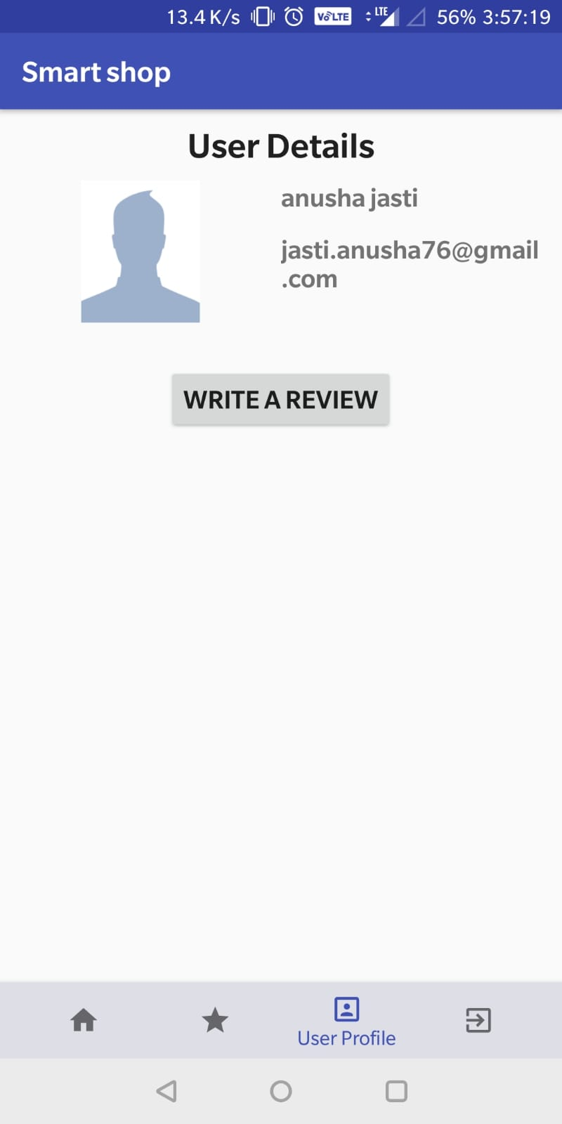
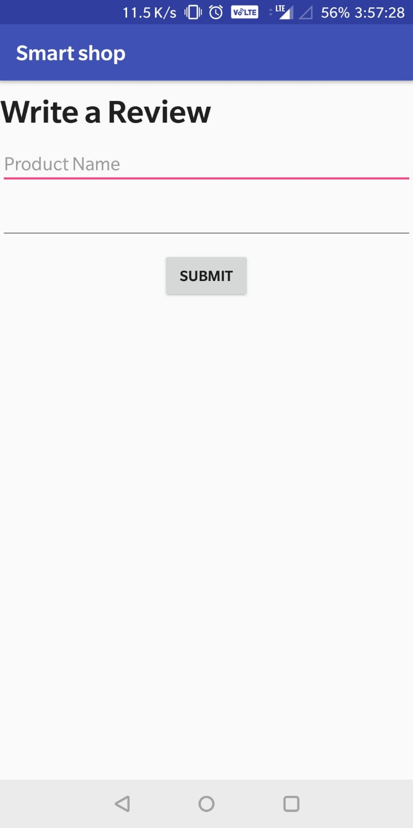

Slide 10
Future Work:
To integrate more API’s
To provide directions to the nearby store
Adding wishlist
Integrating the reviews from API’s and firebase.

Slide 11
Thank You

